Slide 1
Converting analog data to binary
Mack 2021

Slide 2
Converting analog data to binary
The real world is analog, a continuous stream of varying data.
Just look around you, beyond your computer or phone. There's an infinite amount of visual information. If you zoom into one part of your visual field, you can notice more and more details.
Now sing a little song to yourself. That's an infinite stream of audio information. Your voice is constantly changing in big and little ways, microsecond by microsecond.
Analog data is infinitely detailed. Computers can only store digital data, finite data in a binary representation.
So how can we capture the wondrous analog world of our senses and convert it into digital data? We can use a process of sampling, quantization, and binary encoding.

Slide 3
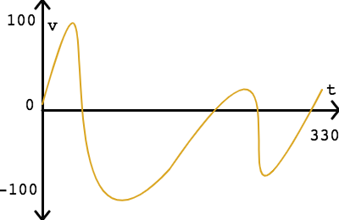
An analog signal
Let's start with a simple analog signal, a waveform representing a sound: All analog signals are continuous both in the time domain (x-axis) and in the amplitude domain (y-axis). That means that there is a precise value for every possible value of time, even as specific as "1.2345 seconds", and that value may be as precise as "47.8291824806423964 volts".

Slide 4
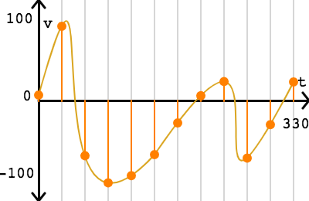
Sampling
The first step is sampling, where we take a sample at regular time intervals. This step reduces the continuous time domain into a series of discrete intervals.
In this signal, where time varies from 0 to 330 milliseconds, we could take a sample every 30 milliseconds:
That gives us 12 samples of the signal between 0 and 330 milliseconds.

Slide 5
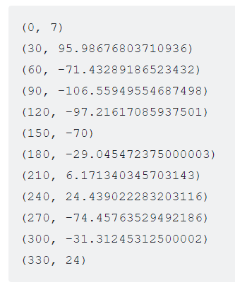
Now we can express the signal as a series of sampled points:
The y-values are only as precise as our computer can store; numbers stored in computers aren't infinitely precise and may be rounded off.

Slide 6
Sampling
The inverse of the sampling interval is the sampling rate: the number of samples in a second (or other unit of time). For example, a sampling interval of 30 milliseconds corresponds to a sampling rate of 33.33 samples per second.
According to the Nyquist-Shannon sampling theorem, a sufficient sampling rate is anything larger than twice the highest frequency in the signal. The frequency is the number of cycles per second and measured in Hz (hertz). If a signal has a maximum frequency of 500 Hz, a sufficient sampling rate is anything greater than 1000 Hz.
A typical sampling rate for music recordings is 48 kHz (48,000 samples per second). That's a little over double the highest frequency that humans can hear, 20 kHz. If the audio only contains human speech, as is often the case for phone calls, a much smaller sampling rate of 8 kHz can be used since 4kHz is the highest frequency in most speech.

Slide 7
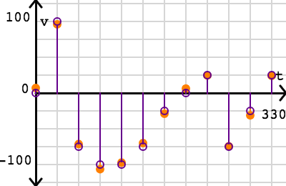
Quantization
After sampling, we are still left with a wide range in the amplitude domain, the y values. The next step of quantization reduces that continuous amplitude domain into discrete levels.
For our simple signal, where amplitude varies from -100 to 100 volts, we can apply a quantization interval of 25 volts:

Slide 8
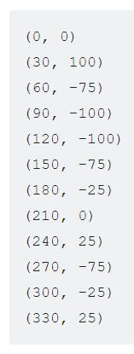
Now the 12 points all have y values that are multiples of 25:
The ideal quantization interval depends on our use case and physical constraints. If there is enough space to represent thousands of different y values, then we can use a very small quantization interval. If there is limited space, then we can use a large interval.
The quantizing step always introduces some amount of quantization error, which is measured by comparing the actual signal value with the quantized value at each sampled point. However, some level of quantization is always necessary for storing analog data in digital form, due to the finite nature of a computer's memory and its numeric precision.

Slide 9
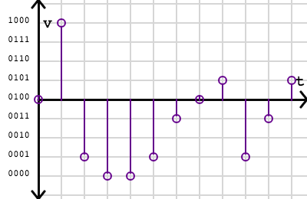
Binary encoding
That brings us to the final step: binary encoding. If there is a limited set of quantized y values, the computer does not need to store the actual value. Instead, it can store a much smaller value that represents the quantized y value.
For this signal, a quantization interval of 25 resulted in 9 possible y values. We can map the 9 values to the binary numbers 0000 - 1001:

Slide 10

We can then encode the signal into this binary sequence:
For a computer to understand that sequence, our digitized version would also need to include a description of how the sequence was sampled and encoded.
This encoding uses 4 bits per sample. The number of bits per sample is also know as the bit depth. The lowest bit depth is 1, which can only describe 2 values (0 or 1). The standard bit depth for telephone calls is 8 bits (256 values) and the recommended bit depth for YouTube music videos is 24 bits (over 16 million values).

Slide 11
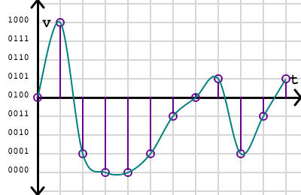
Reconstruction
We often store analog signals in digital storage so that we can reproduce them later, like playing back an audio file or displaying an image. When a device wants to convert a digitized signal back into an analog signal, it will attempt to reconstruct the original continuous signal.
For this signal, a simple reconstruction strategy could interpolate a smooth curve through the quantized points:

Slide 12
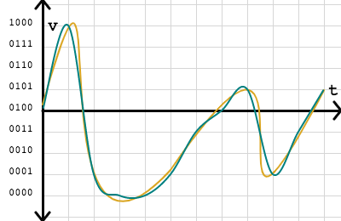
How well does that match the original? We can overlay the curves to see the difference visually:
The reconstructed signal looks very close to the original, but misses a few details. If we can decrease the sampling interval and lower the quantization error, we can bring the reconstructed curve closer to the original signal. We could also use different strategies for reconstructing the signal.

Slide 13
Summary
The first step of sampling converted an infinite stream to a finite sequence. In quantization, the values in that sequence were approximated. Finally, the values were encoded into bits for storage on a computing device. At some later point, a device could interpret those bits to attempt a reconstruction of the original infinite stream of continuous values.
Whenever we convert analog data to digital data, whether it's audio or visual, our goal is to sample data with enough precision so that we can reconstruct it later at the desired quality level but not exceed our data storage capacity.
Land-line telephones use relatively low sampling rates and bit depths, since the data must travel over telephone lines, whereas movie directors record film at very high sampling rates and bit depths, so that they may replay it on giant screens later.

Slide 14
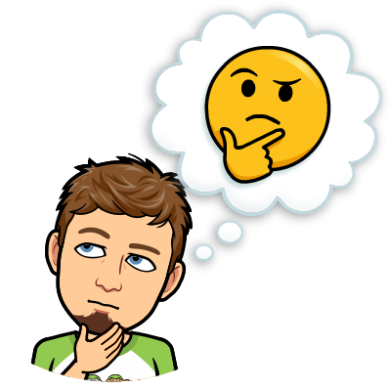
Check your Understanding
🤔 Find a device near you that converts analog data into digital data. What sort of space constraints does it have for storing or transferring the data? What sort of detail is lost in the digitized version?
Notes:
🍐 This is a Pear Deck Text Slide
🍐 To edit the type of question, go back to the "Ask Students a Question" in the Pear Deck sidebar.

Slide 15

Questions?

Slide 16
Practice

Slide 17
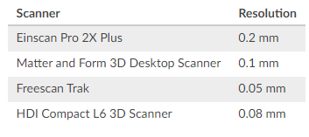
3D scanners use projected light to understand the shape of an object and convert it into a 3D point cloud. Each scanner is capable of scanning up to a particular resolution, the minimum distance between two scanned points.
This table lists the resolutions of various 3D scanners:
Which of the following comparisons between 3D scanners is the most likely to be true?
Notes:
🍐 This is a Pear Deck Multiple Choice Slide. Your current options are: A: The HDI Compact L6 scanner may miss some details that the Matter and Form scanner captures., B: The HDI Compact L6 scanner will use more bits to represent each point than the Einscan Pro 2X scanner., C: The Freescan Trak scanner will use fewer bits to represent each point than the Matter and Form scanner., D: The Freescan Trak scanner may capture some detail of the object that the Einscan Pro 2X Plus scanner misses.,
🍐 To edit the type of question or choices, go back to the "Ask Students a Question" in the Pear Deck sidebar.
D

Slide 18
A programmer is writing the code for a sports website that will use a variety of data sources. They want to understand which data sources are analog so that they can think carefully about the process of converting the analog data into digital data.
Which of these data sources is analog?
Notes:
🍐 This is a Pear Deck Multiple Choice Slide. Your current options are: A: A list of teams competing in a lacrosse tournament, B: The final scores of ten basketball games, C: A swimmer's position in the pool as they swim from one end to the other, D: The number of players sitting on the bench during a basketball game,
🍐 To edit the type of question or choices, go back to the "Ask Students a Question" in the Pear Deck sidebar.
C

Slide 19
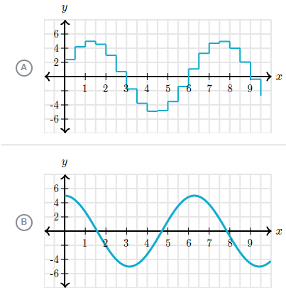
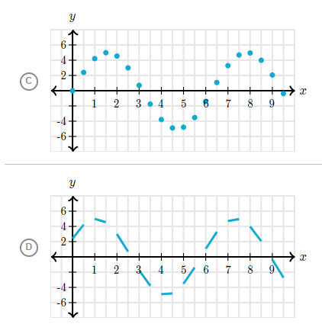
Which of these graphs is the best illustration of analog data?
Notes:
🍐 This is a Pear Deck Multiple Choice Slide. Your current options are: A: A, B: B, C: C, D: D,
🍐 To edit the type of question or choices, go back to the "Ask Students a Question" in the Pear Deck sidebar.
B

Slide 20
What is true about the process of converting analog data into digital data?
Notes:
🍐 This is a Pear Deck Multiple Choice Slide. Your current options are: A: The digital version contains all of the details of the analog data, as long as enough storage capacity is available., B: To make the digital version be a more accurate representation of the analog data, the process should use fewer bits to represent each sample, C: A longer interval between measured samples means more details will be captured in the conversion from analog to digital, D: The digital version is a representation of the analog data but cannot include all of the details,
🍐 To edit the type of question or choices, go back to the "Ask Students a Question" in the Pear Deck sidebar.
D

